Slide 1
Dr Kehinde D. OYEYEMI
Department of physics

Slide 2

TUTORIAL 1

Slide 3
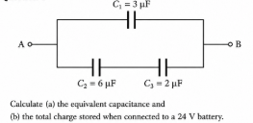
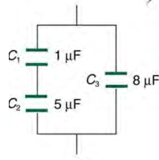


Slide 4
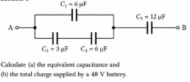
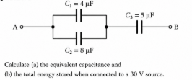








Slide 5
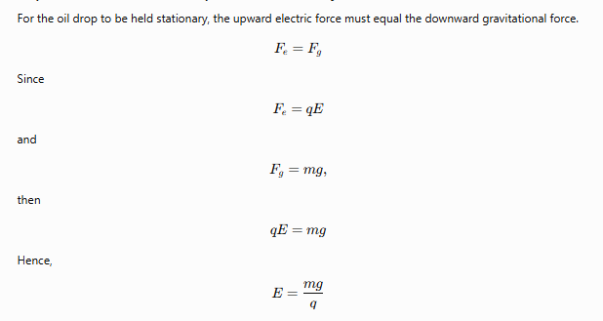
Calculate the electric field in which a charged oil drops of mass 8 mg and charged +9 µC will be held stationary.

Slide 6


What is the capacitance of a capacitor having a stored energy of 2.25 mJ after being charged with a 30-volt source?

Slide 7


Calculate the magnitude of the electric
field intensity represented by

Slide 8

A conducting sphere of radius 0.25 m carries a total charge of 6 × 10⁻⁶ C. Calculate the electric field at a point 0.50 m from the center of the sphere.

Slide 9
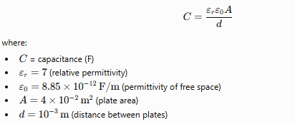
The area of each plate of a parallel plate capacitor is 4 x 10⁻² m². If the thickness of the dielectric placed in between the plates is 10⁻³ m and the relative permittivity of the dielectric is 7, then the capacitance of the capacitor is?

Slide 10
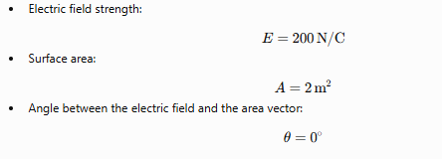
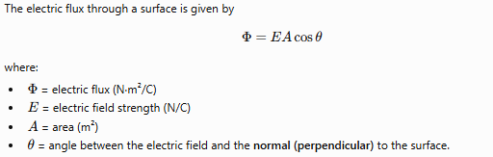
A uniform electric field E = 200 N/C passes through a surface of area 2 m² at 0⁰. Find Flux.

Slide 11
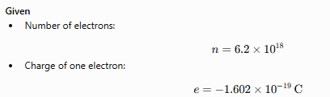

What is the charge of a system that has 6.2 x 10¹⁸ electrons?

Slide 12
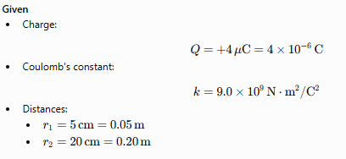
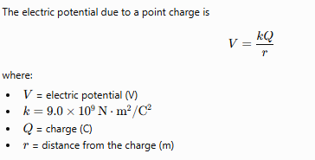
What is the absolute potential at each of the following distances from a charge of +4 μC in air: r = 5 cm and r = 20 cm?

Slide 13

Given a circuit where R1, R2 and R3 are in series with a voltage source of 48 V, such that R1 = 7 Ω, R2 = 6 Ω and R3 = 3 Ω, calculate the current that flows through R3?

Slide 14
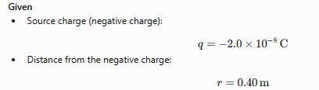


A charge of 8 x 10⁻⁸ C is 0.40 m from a charge of -2.0 x 10⁻⁸ C. Determine the electric field produced by the negative charge at the location of the positive charge.

Slide 15
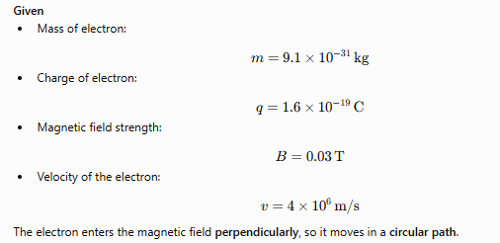
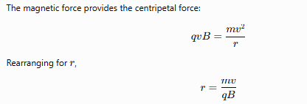
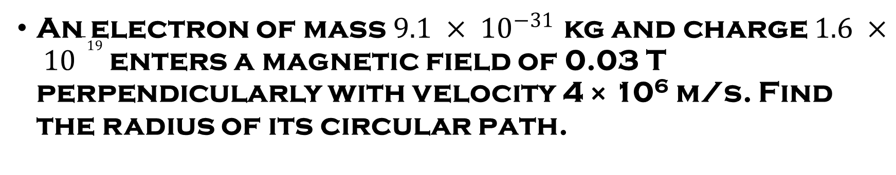
An electron of mass $9.1 × {10}^{−31}$ kg and charge $1.6 × {10}^{−19}$enters a magnetic field of 0.03 T perpendicularly with velocity 4 × 10⁶ m/s. Find the radius of its circular path.

Slide 16
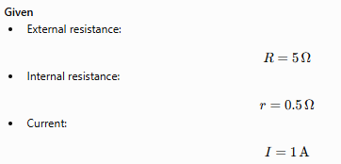
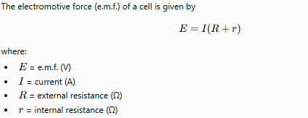

In a circuit, the external resistor has a value of 5 Ω. The internal resistance of the cell is 0.5 Ω. If the current flowing is 1 A. Calculate the e.m.f of the cell.

Slide 17
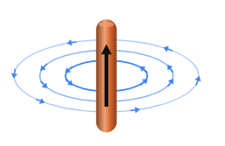
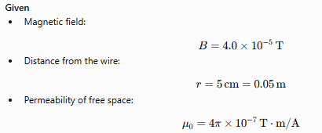
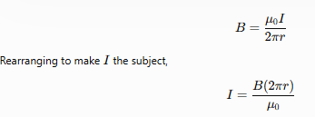
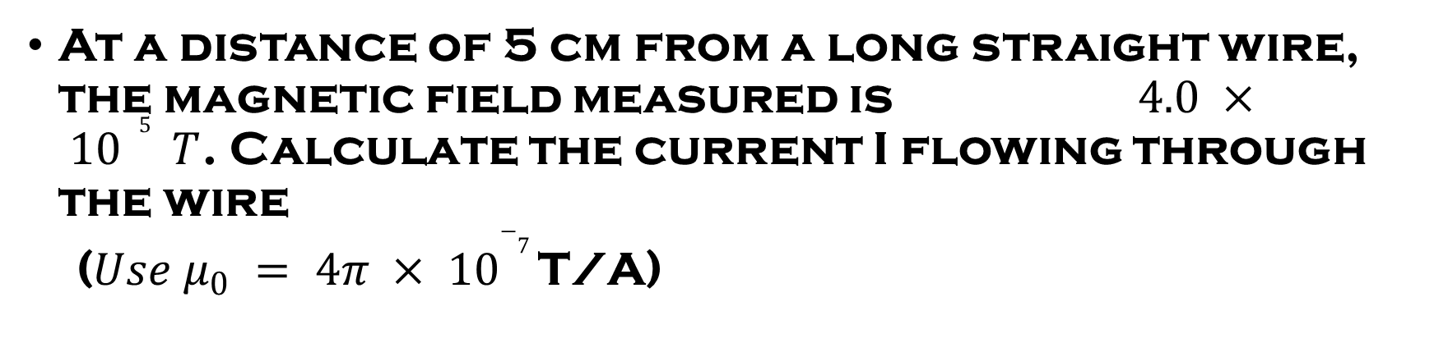
At a distance of 5 cm from a long straight wire, the magnetic field measured is $4.0 × {10}^{−5 } T$. Calculate the current I flowing through the wire
($Use μ_{0} = 4π × {10}^{−7}$T/A)

Slide 18
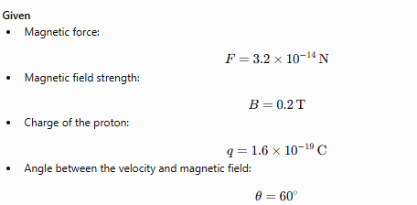
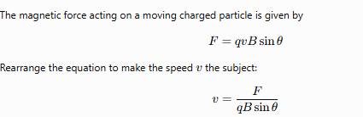
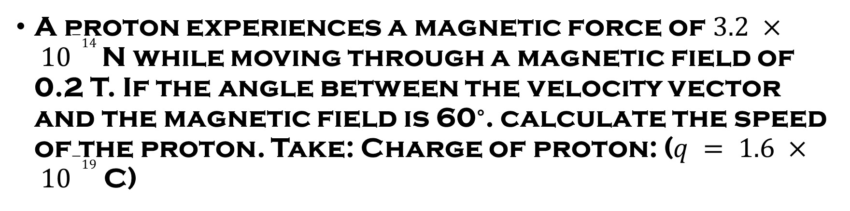
A proton experiences a magnetic force of $3.2 × {10}^{−14}$ N while moving through a magnetic field of 0.2 T. If the angle between the velocity vector and the magnetic field is 60∘. calculate the speed of the proton. Take: Charge of proton: ($q = 1.6 × {10}^{−19}$ C)

Slide 19
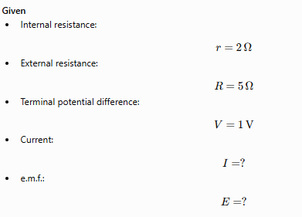


A cell of unknown e.m.f E, and internal resistance 2 Ω is connected to a 5 Ω resistor. If the terminal p.d. is 1 volt, calculate the value of “E” if a current of “I” flows through the cell.

Slide 20
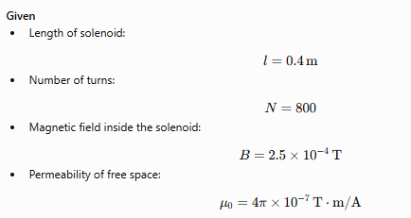
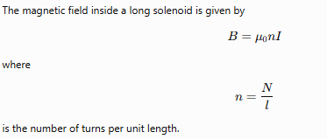
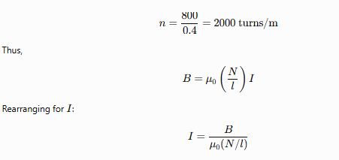
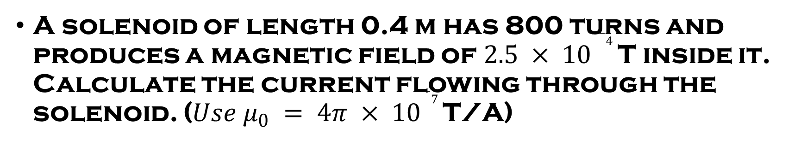
A solenoid of length 0.4 m has 800 turns and produces a magnetic field of $2.5 × {10 }^{−4}$ T inside it. Calculate the current flowing through the solenoid. ($Use μ_{0} = 4π × {10}^{−7}$T/A)

Slide 21
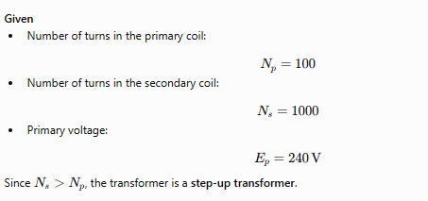
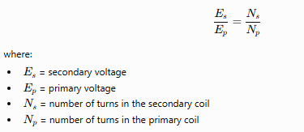
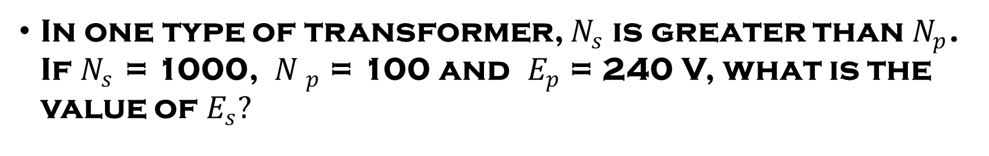
In one type of transformer, $N_{s}$is greater than $N_{p}$. If $N_{s}$ = 1000,${ N }_{p}$ = 100 and $E_{p}$ = 240 V, what is the value of $E_{s}?$

Slide 22
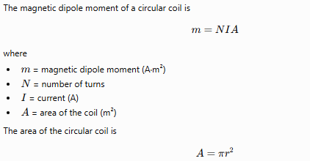
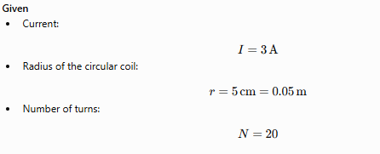
A current of 3 A flows in a circular coil of radius 5 cm with 20 turns. Calculate the magnetic dipole moment.

Slide 23
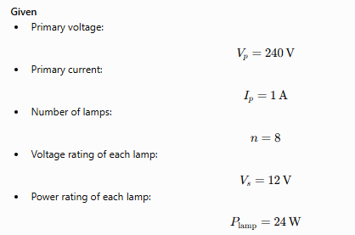
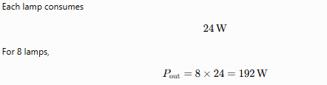
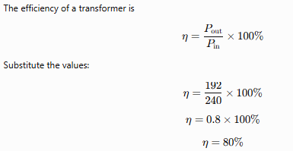
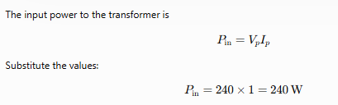
A 240 V step-down transformer is used to light up eight 12 V, 24 W lamps and draws a current of 1 A in the primary. Calculate its efficiency.

Slide 24
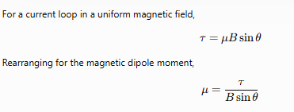
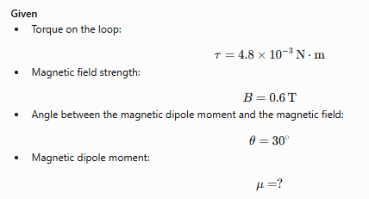
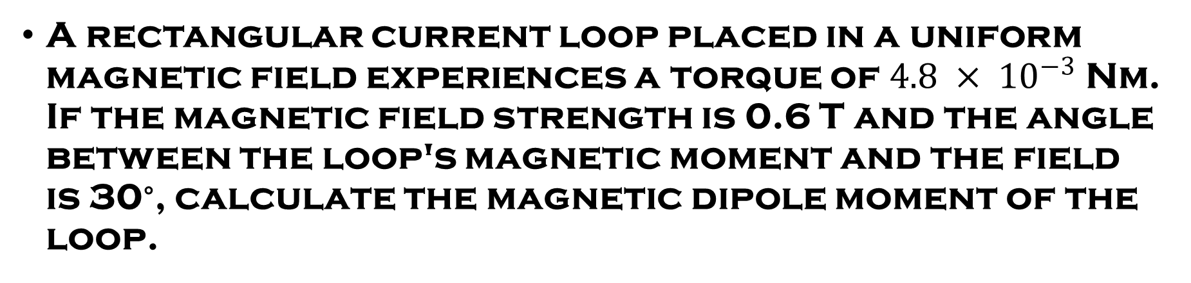
A rectangular current loop placed in a uniform magnetic field experiences a torque of $4.8 × {10}^{−3}$Nm. If the magnetic field strength is 0.6 T and the angle between the loop's magnetic moment and the field is 30∘, calculate the magnetic dipole moment of the loop.

Slide 25
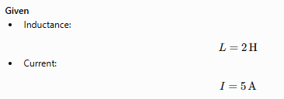

A 2 H inductor carries 5 A of current. What is the stored energy?

Slide 26
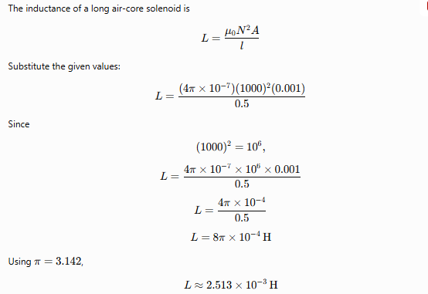
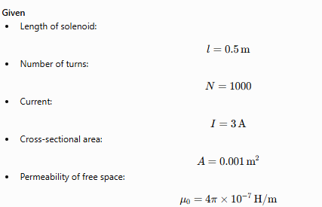

A solenoid 0.5 m long has 1000 turns and carries 3 A current. Find the energy stored in it (area = 0.001 m²).

Slide 27
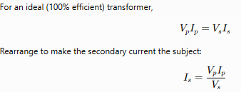
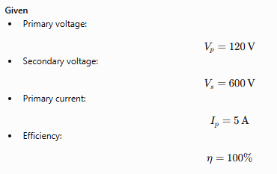
A step-up transformer increases the voltage from 120 V to 600 V. If the primary current is 5 A, what is the secondary current assuming 100% efficiency?

